Slide 1

Credit EDA case study
- by Rushabh Kawadkar

Slide 2
Business Understanding:-
The loan providing companies find it hard to give loans to the people due to their insufficient or non-existent credit history. Because of that, some consumers use it to their advantage by becoming a defaulter. Suppose you work for a consumer finance company which specialises in lending various types of loans to urban customers. You have to use EDA to analyse the patterns present in the data. This will ensure that the applicants capable of repaying the loan are not rejected.
When the company receives a loan application, the company has to decide for loan approval based on the applicant’s profile. Two types of risks are associated with the bank’s decision:
If the applicant is likely to repay the loan, then not approving the loan results in a loss of business to the company
If the applicant is not likely to repay the loan, i.e. he/she is likely to default, then approving the loan may lead to a financial loss for the company.

Slide 3
Business Objectives:-
This case study aims to identify patterns which indicate if a client has difficulty paying their instalments which may be used for taking actions such as denying the loan, reducing the amount of loan, lending (to risky applicants) at a higher interest rate, etc. This will ensure that the consumers capable of repaying the loan are not rejected. Identification of such applicants using EDA is the aim of this case study.
In other words, the company wants to understand the driving factors (or driver variables) behind loan default, i.e. the variables which are strong indicators of default. The company can utilise this knowledge for its portfolio and risk assessment.
To develop your understanding of the domain, you are advised to independently research a little about risk analytics - understanding the types of variables and their significance should be enough.

Slide 4
Steps Followed:-
Data Understanding and Sourcing
Check Data Quality issues and Binning
Data Cleaning and Manipulation
Outlier Check and Data Imbalance check.
Data Analysis: performing statistics operation, oriented analysis, univariate and bivariate analyses, correlation, and creating plots to find better insights.
Data analysis on both merging dataset application data and previous application.
Conclusion and Presentation of overall Analysis.

Slide 5
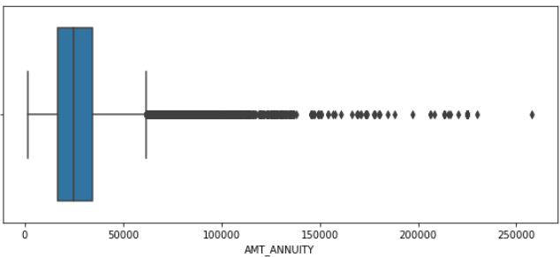
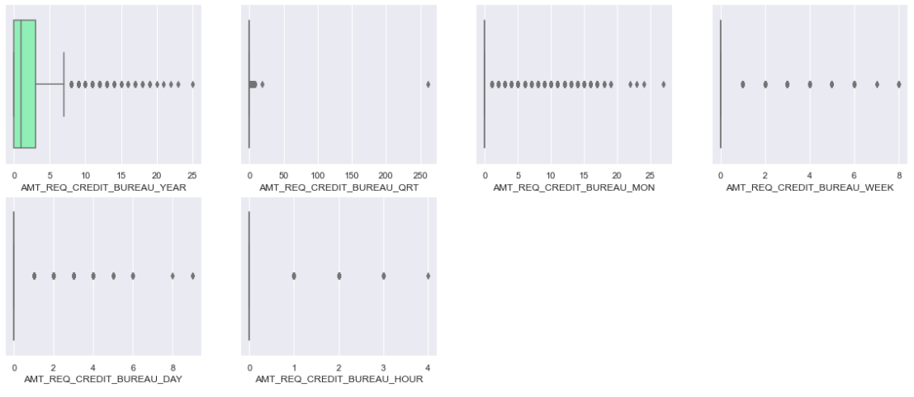
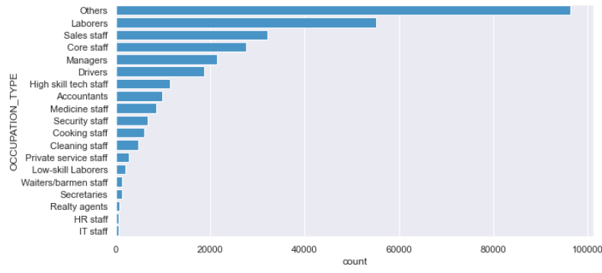
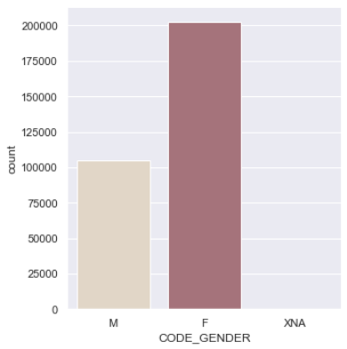
Application data Analysis:-
Outlier Check and Missing Value treatment in both Categorical and Numerical Columns:
There are many missing values & outlier present in the dataset, its treated by performing imputation, adding mean, median also dropping the columns.

Slide 6
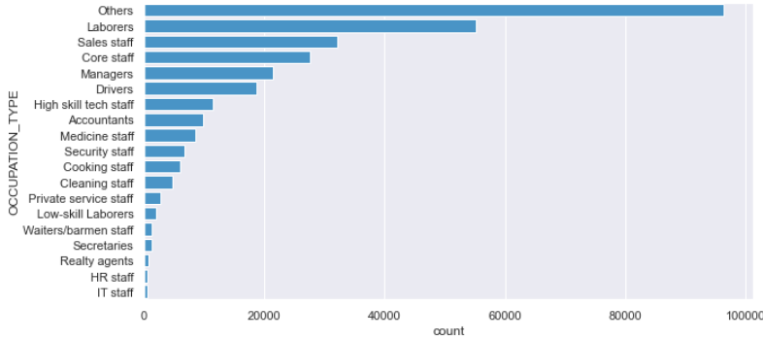
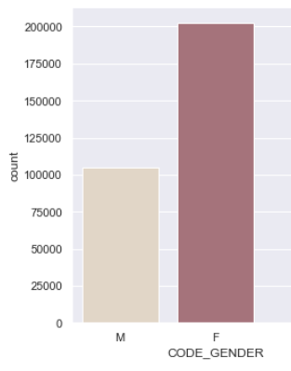
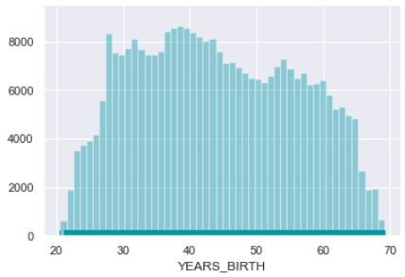
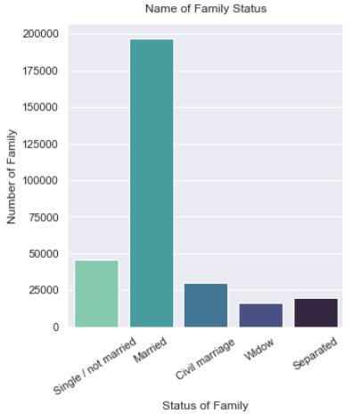
Insights from other data columns after treatment data imbalance and outlier check : -
In occupation type column it is observed that the Others and laborers category are major applying for loan.
In Gender column its observed that Female is the highest category before male applying loans.
As in distribution plot the age column shows that the application starts from minimum 21 to maximum 69. Most of the applicant from 27-45 age group of people.
In family status column chart its is observed married people are mostly applied for loan followed by single and unmarried. Widows are the least number application for loan.

Slide 7
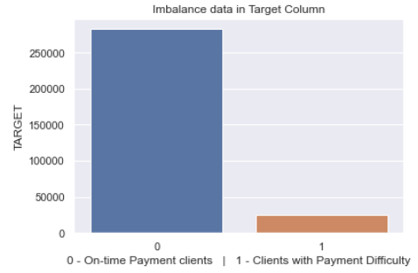
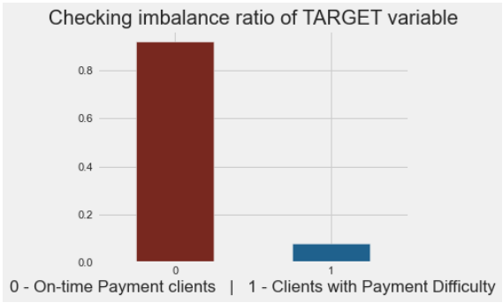
Checking Data Imbalance for Target Column:-
It appears that 1 in every 11 applicants has difficulty making payments.
91.92% of clients have on-time payment, while 8.07% have difficulty with payment.

Slide 8
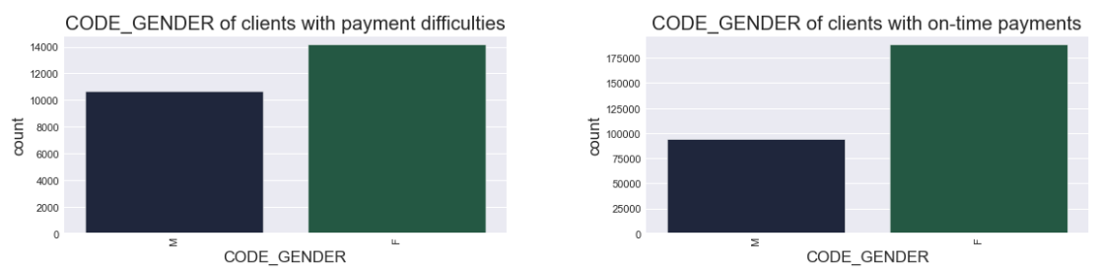
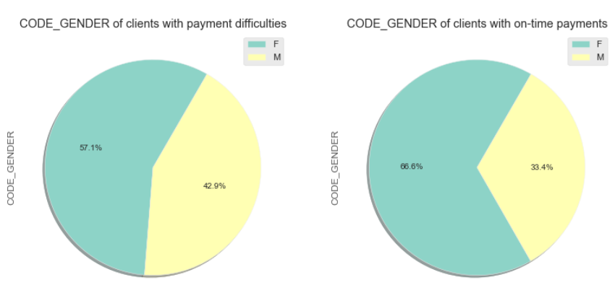
Univariate Analysis:-
Female Processed more Loan as compare to Male.
There is 9.4% decrease in male values from code gender clients with payments difficulty to on time payment.
Male applicant has more defaulting than Female applicants.
Female clients who are working are more likely to make on time payment.

Slide 9
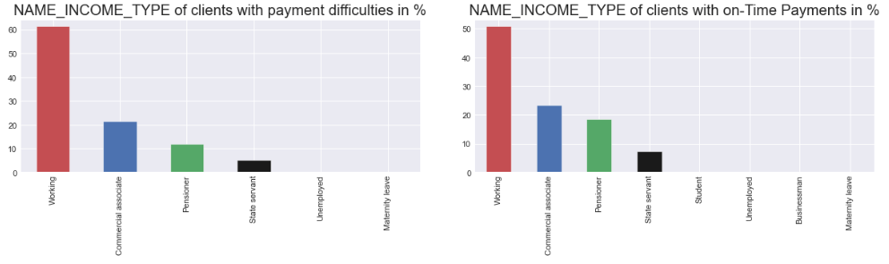
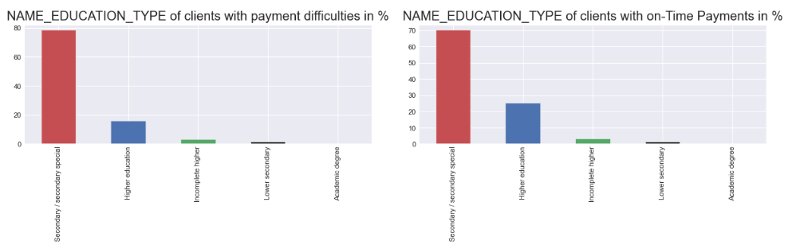
Working class processed more loans than other categories.
Pensioner have on time payment,
Students don’t have more payment difficulty
Business's don’t have more payment difficulty
Customer with have Higher Education have better on time payments than others
Customer with academic degree should get higher preference.

Slide 10
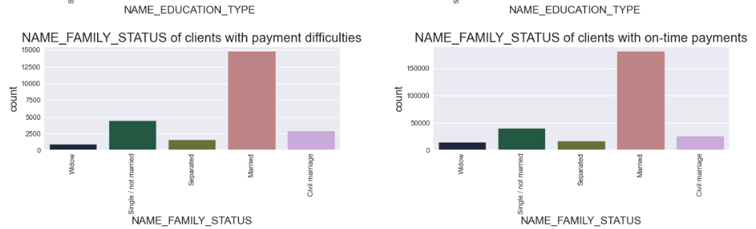
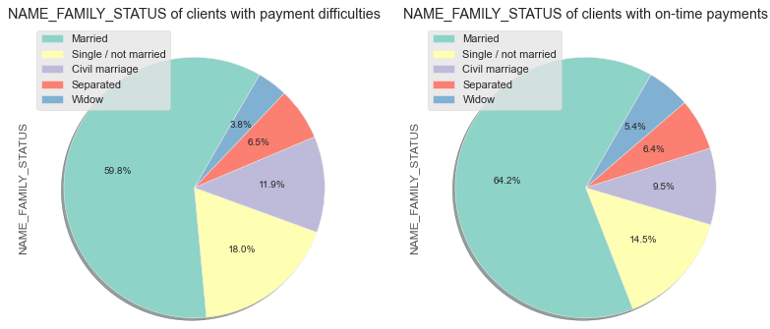
people with 0 children are more work problem to make on time payment
customer who are married or widow do on time payments better comparatively.
Customer who are single and not married have more difficulties with on time payments comparatively.
Married people are the ones mostly applying for followed by single or not married.
widows are the ones who have least number of application for loan.

Slide 11
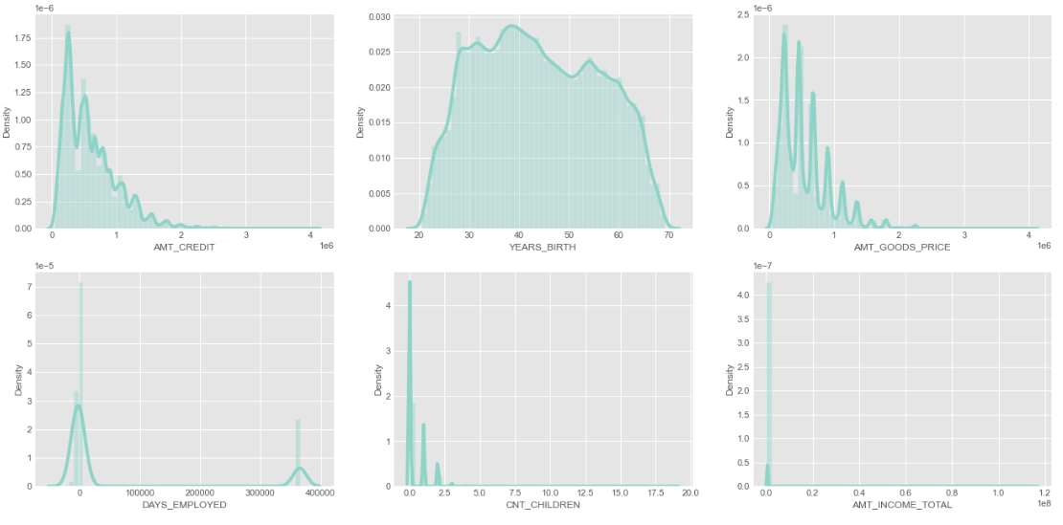
Performing Analysis on Numerical Columns:-
There is a clear trend that as the AMT_CREDIT and AMT_GOODS_PRICE increase, there are more clients with Payment difficulties.
For YEARS_BIRTH, there are more clients with Payment difficulties between 20 and 40, and more clients with on-Time Payments over 40.
For DAYS_EMPLOYED, there are more clients with Payment difficulties for those employed less than 2000 days, and more clients with on-Time Payments for those employed over 2000 days.
For CNT_CHILDREN, there are more clients with on-Time Payments for those with no children, and a few more clients with on-Time Payments for those with 1 or 2 children.
Finally, the distributions of AMT_INCOME_TOTAL are significantly different for those with Payment difficulties and those with on-Time Payments, with the former resembling a normal distribution and the latter resembling a lowered normal distribution.

Slide 12
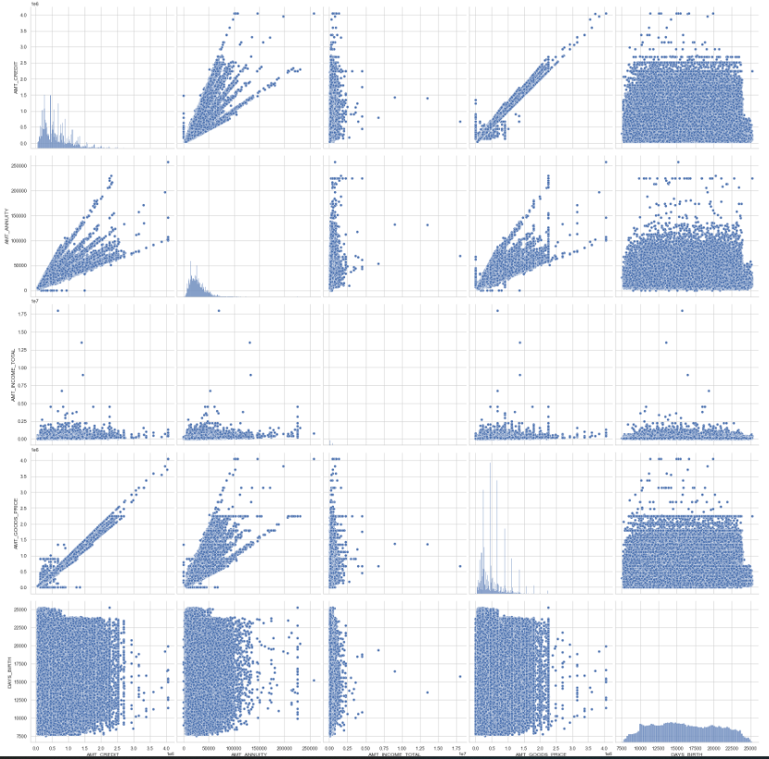
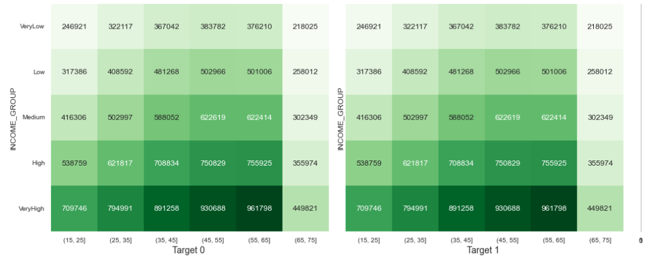
Bivariate, Multivariate and Correlation Analysis:-
Conclusion:
In conclusion, the target market for the company are clients in the age range 30-40 and 40-50, female clients who are working, clients who are married, male clients with academic degree, students and businessmen, and repeater clients most targeted for loans

Slide 13
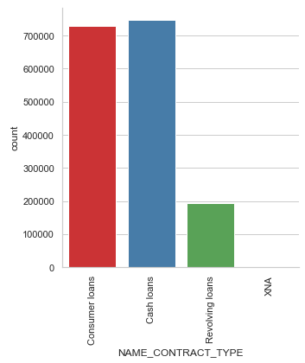
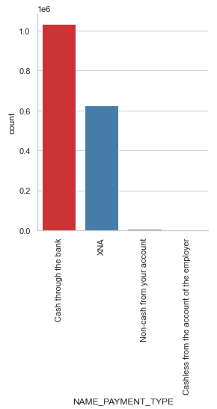
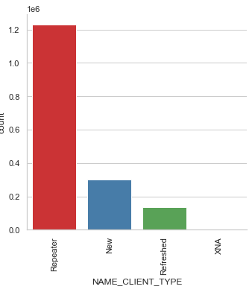
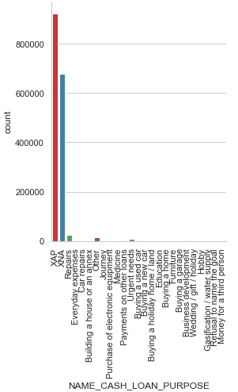
Previous Application Analysis:-
Its observed a cash loans seem not to have been cancelled, while consumer loans have refused more often than cash loans. The bank has more repeaters in all approved, refused, unused category.

Slide 14
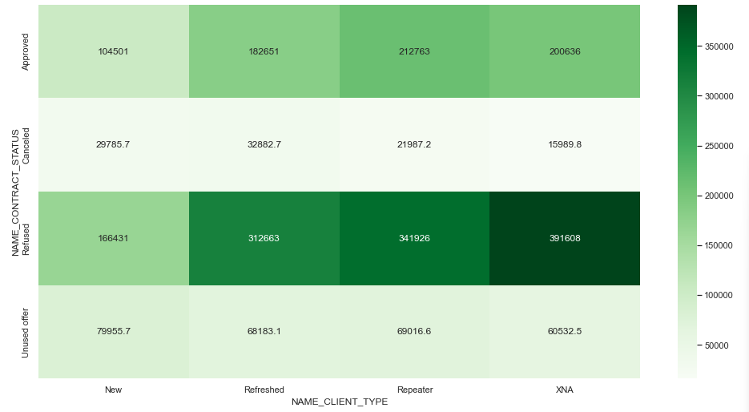
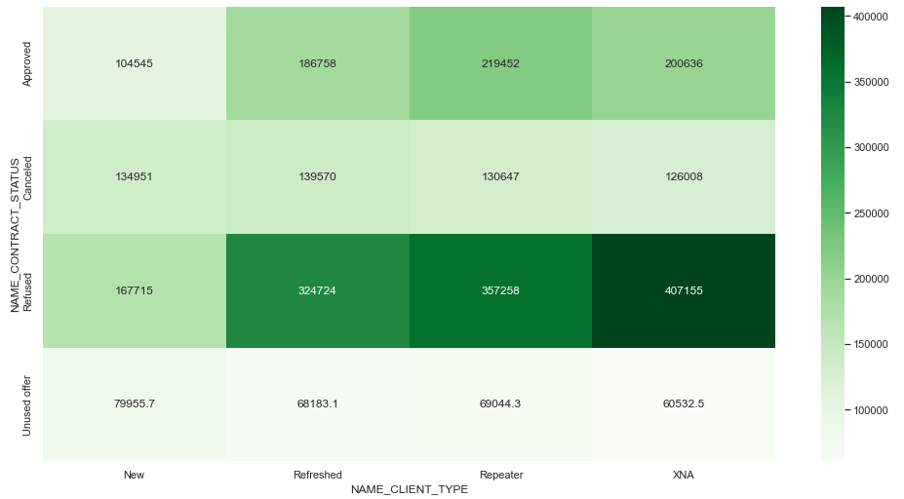
Bi-variate Analysis:-
Conclusion:-
The variables below were set up as defaults in the analysis of the application data frame. Checked against approved loans that have defaulted and proved to be correct.
Moderate income,25-35 age people followed 35-45 group people, Gender of the applicant, Employment type, Occupation types, House type ae similar in both information.
Other important factors to consider include the number of bureau hits in the past week, month, etc. A zero hit is good. The amount of income equivalent to the purchase of a good is also a concern. Past applications with rejected, cancelled, or unused loans also have defaults, which is a matter of concern. This indicates that the financial company may have rejected or cancelled the previous application but has approved the present one, and is now facing default on the same. Trusted applicants who have been rejected may have a lower loan amount, but this should not be a reason to not use them. Additional weightage should be given to women applicants as defaults are less. Students and business people are usually considered to be low-risk when it comes to repaying a loan. There are also cases in which people with previous rejected, cancelled, or unused loans are making their payments on time in the current application. This indicates that possibly wrong decisions were made in those

Slide 15
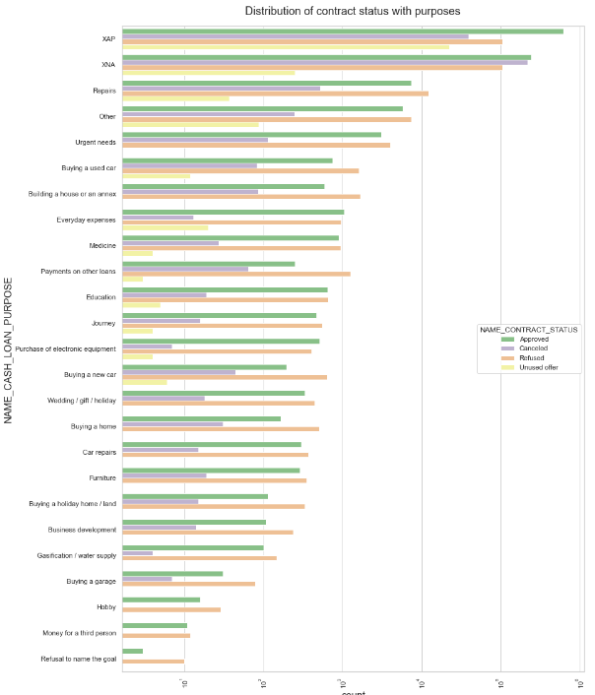
Performing Analysis by Merging Dataset :-
Most loan rejections came from the category of 'repairs', while an equal number of loans were approved and rejected for education purposes. Significantly more loan applications were rejected than approved for the purposes of paying off other loans or buying a new car.

Slide 16
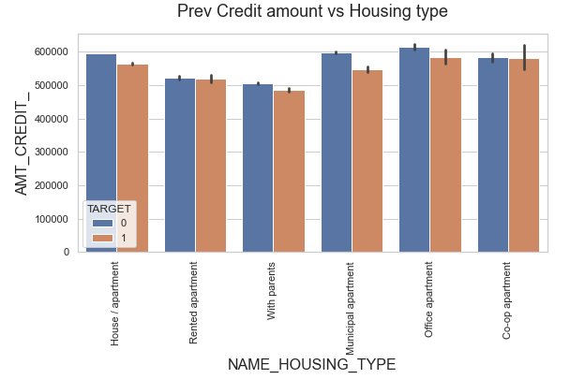
Here for housing types, office apartments have a higher target credit of 0 and co-op apartments have a higher target credit of1.Therefore, we can conclude that the bank should refrain from lending to housing type co-operative apartments as they face difficulties in payments. For successful distribution the bank can focus mainly on housing type including parent or house/apartment or municipal apartment.

Slide 17
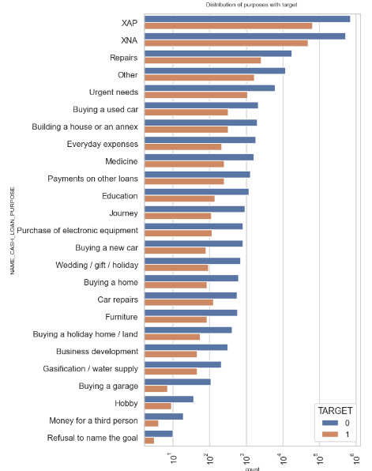
Conclusion:
In order to be successful, banks should focus more on contract type ‘Student’, ‘Pensioner’ and ‘Businessman’ with housing type other than ‘Co-op apartment’. They should focus less on income type ‘Working’ as they are having the most number of unsuccessful payments. Loan purpose ‘Repair’ is also having a higher number of unsuccessful payments on time. Banks should try to get as many clients from housing type ‘With parents’ as they are having the least number of unsuccessful payments.

